Slide 1
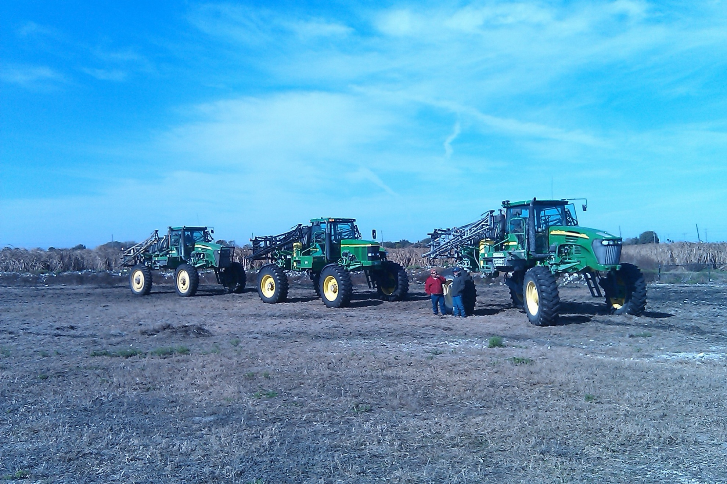
Proper Pesticide Application
Stewart Swanson and Matt VanWeelden

Slide 2
The Importance of YOU and what you DO!
Pest control is a critical factor in crop production
Proper pesticide application protects the crop, saves money and protects the health of humans and the environment
Attentive and professional applicators are a key factor in any successful agricultural operation

Slide 3
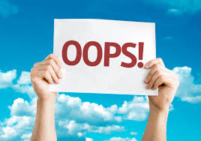
Attentive and professional
applicators are a key factor
in any successful agricultural operation

Slide 4
Improper Application is Serious Business
Arkansas and Missouri have halted the sale and use of the herbicide Dicamba because of drift damage to sensitive crops.

Slide 5
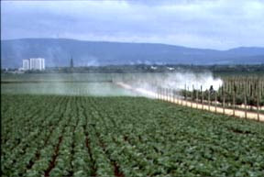
Pesticide Drift
Movement of Pesticide Beyond the Designated Target
Undesirable Consequences of Drift
Inefficient use of equipment and time
Ineffective control
Damage to susceptible off target crops
Litigation concerns
Environmental contamination = water pollution
Human health & safety concerns

Slide 6
Ways to reduce drift
  Only spray when weather conditions are acceptable
  2. Calibrate the sprayer
  3. Nozzle selection: higher volume nozzles have larger droplet size, reducing the tendency for drift
4. Spray pressure: higher pressure causes smaller droplets, increasing the tendency for drift
5. Lower boom if possible

Slide 7
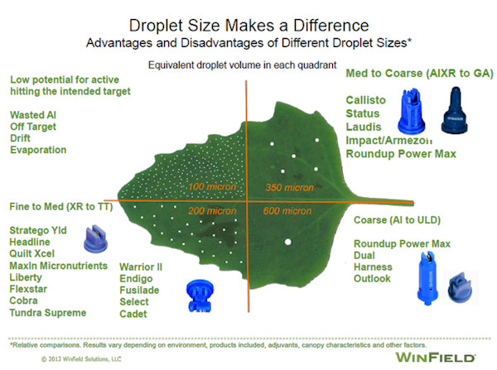
Nozzle Selection

Slide 8
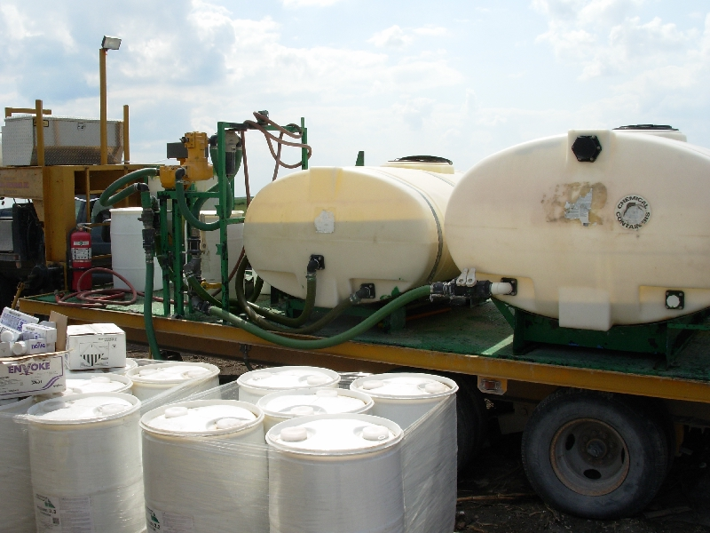
What Pesticides Should We Be Concerned With?
All Of them!
ESPECIALLY
Triazines!!!!
  Atrazine
  Ametryn
  Metribuzin

Slide 9
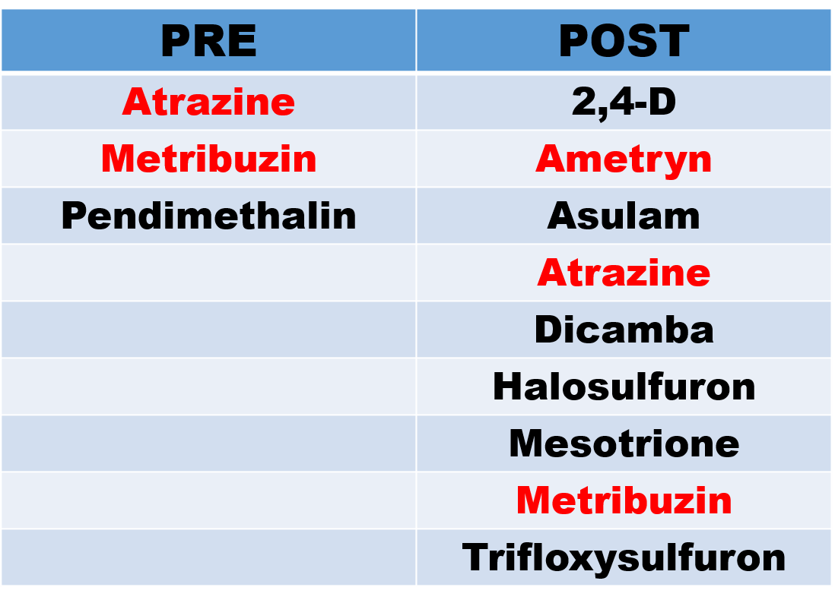
Commonly used herbicides

Slide 10
Reasons for Concern
  Triazines are important herbicides for weed control in FL sugarcane and sod production
  Triazines are commonly found in low concentrations in surface water sampling
  Usage of atrazine has been limited in other areas due to high levels in water

Slide 11
Atrazine (Aatrex, others)
Widely used in FL sugarcane production
  Cheap, Effective, kills more weeds per $$ than most other herbicides
  Safe on cane – no Phyto-toxicity
  Both preemergence and postemergence applications

Slide 12
Ametryn (Evik)
Commonly used in FL sugarcane production
  Postemergence application
  Not as heavily used as atrazine
  under certain conditions and at higher rates, can be phyto-toxic to sugarcane

Slide 13
Metribuzin (Sencor, TriCor, others)
Commonly used in FL sugarcane production
  Labeled in Florida for Postemergence application only!!
  Not as heavily used as atrazine
  SPECIAL PRECAUTIONS (Florida Only): Do not use on sand soils

Slide 14
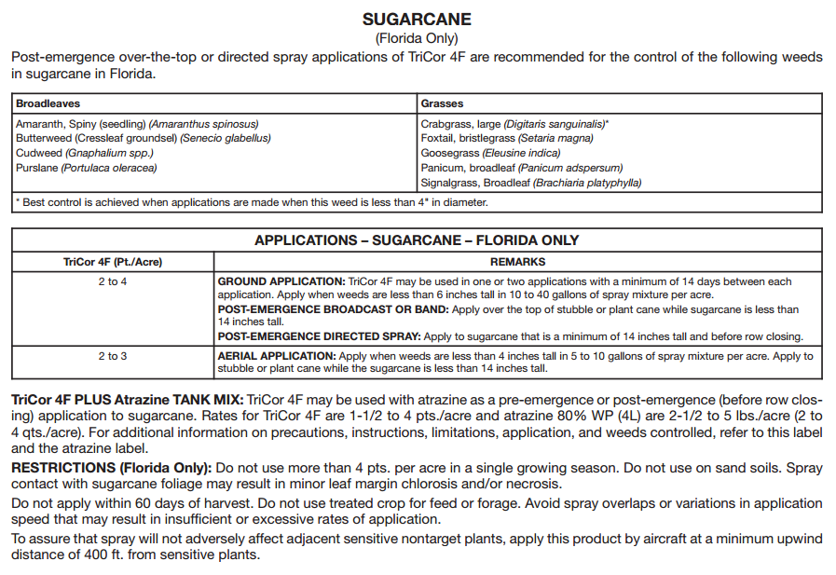

Slide 15
Detection in water sampling
Samples are taken at stations throughout the EAA
20+ years data available
Triazine herbicides are commonly detected at stations in EAA
Levels are generally very low
  But they are often found!!!

Slide 16
What Can We Do To Minimize Triazine Herbicides In Our Surface Waters?
Minimize physical spray drift into bodies of water
Use care when mixing, loading, and spraying herbicides
  Spills near water bodies can result in large amounts of concentrated product entering water
Alternative Herbicides
  Atrazine can provide effective control at lower rates, when tank mixed with other herbicides

Slide 17
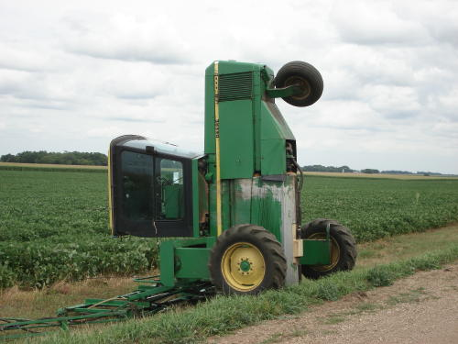

Slide 18
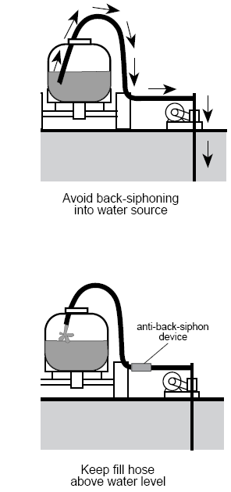
Anti-Back-Siphoning
Make sure all equipment used to supply water is equipped with devices to prevent back-siphoning
Always keep your fill hose above the level of your spray mix

Slide 19
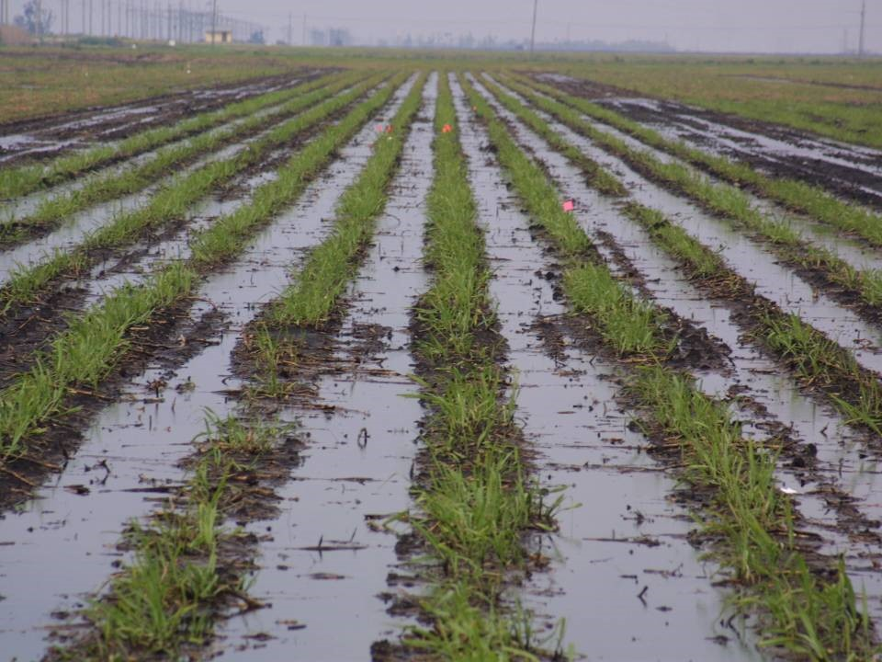
Do not apply to saturated soils
More runoff of both water soluble herbicide, and soil particles.

Slide 22
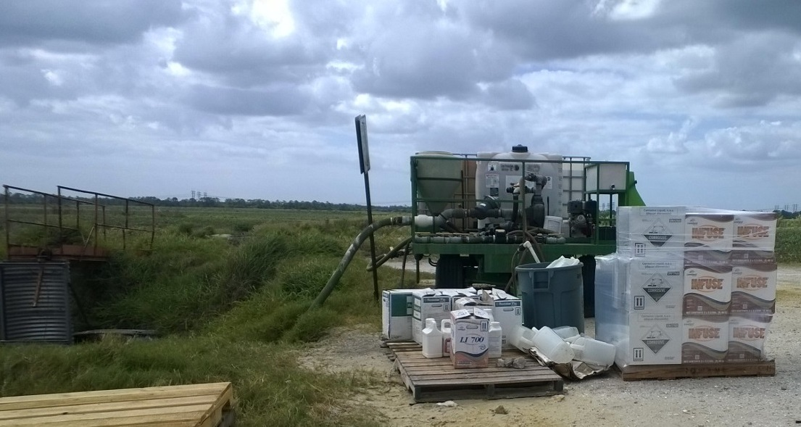
Take Care When Mixing/Loading

Slide 23
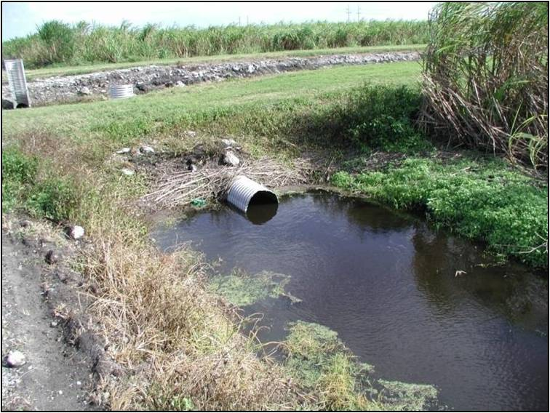
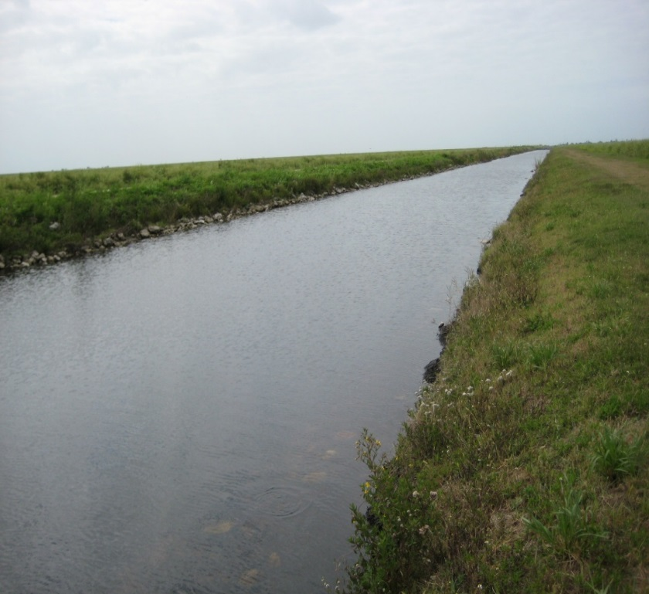
Nutrient BMP’s Impact Herbicide Movement
Vegetative buffers on field edges
  Can reduce movement of herbicides attached to soil particles
Practices that minimize sediment transport
  Herbicides often bound to sediment

Slide 24
Take Home Message
Atrazine, ametryn and metribuzin are important!!
  Good stewardship can minimize the amount of triazine pesticides entering our waters
  When you are out in the field, mixing or spraying; always remember to:
    Use common sense
    Follow label directions

Slide 25
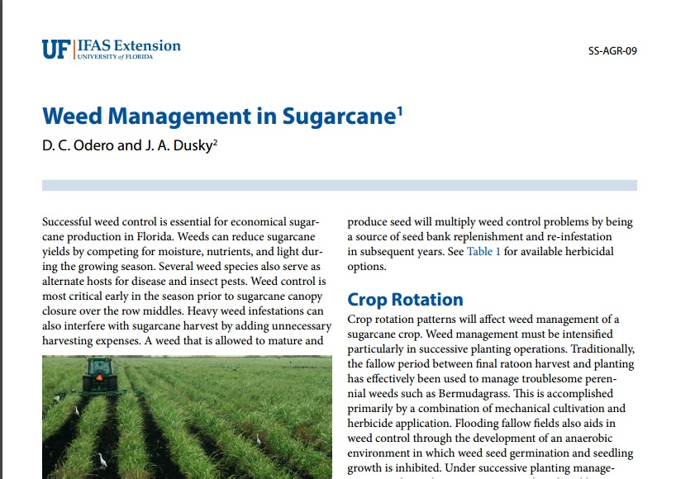
For More Information on Weed Control
http://edis.ifas.ufl.edu/wg004

