Slide 1
Water Management BMPs M. VanWeelden, S. Swanson, T. Lang, J. Bhadha, R. Rice Fall BMP Workshop Everglades Research and Education Center Sept 28, 2017
Notes:
Introduce yourself. Thank people for coming. Go over main topics.

Slide 2
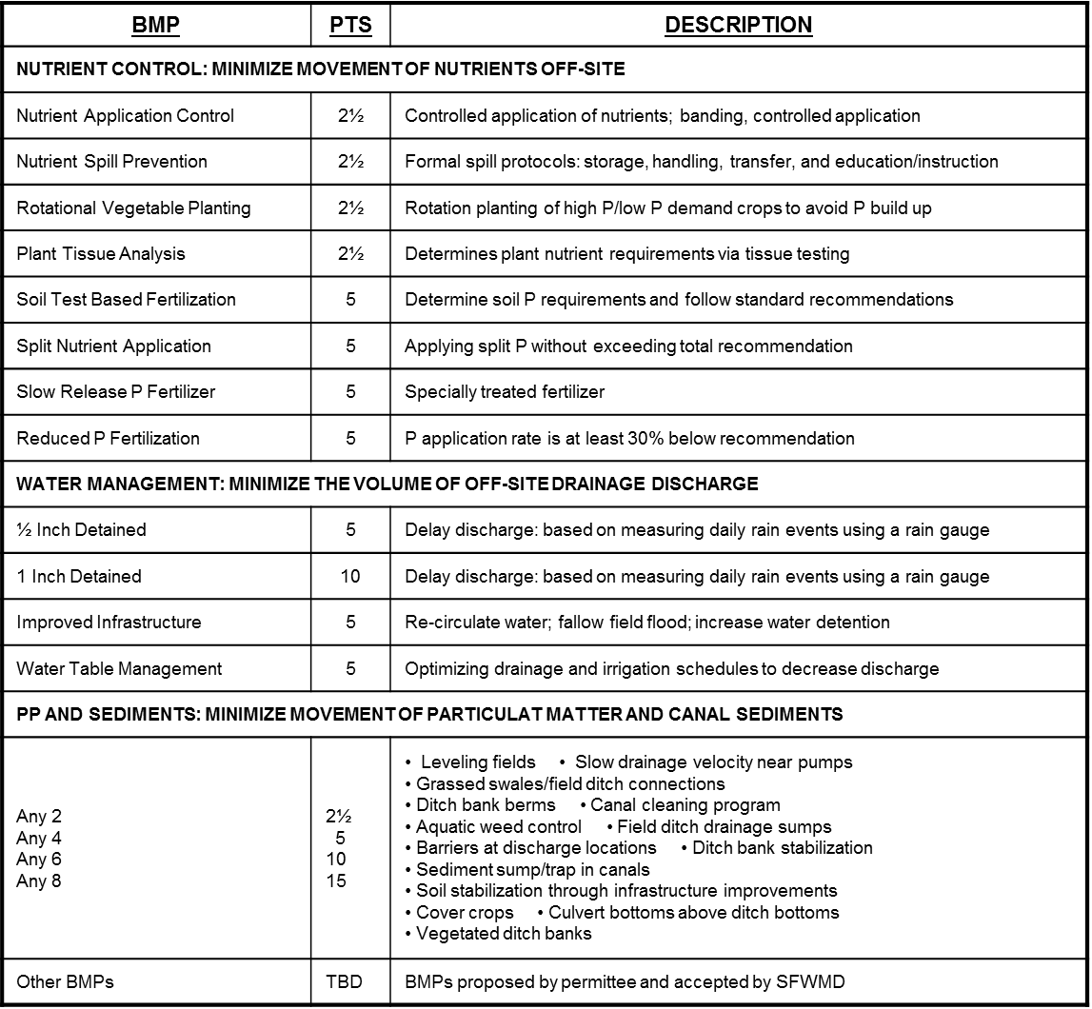

Slide 3
Definitions
Detention: temporarily holding water until conditions for release are met; object is to control discharge rates to reduce impact on downstream receiving systems.
Retention: preventing water from discharging into receiving waters; water is held until it is lost to percolation, evapotranspiration or evaporation.
EAA water management is a combination of detention and retention
Notes:
EAA BMP is detention, but with some scope for reduced volume discharge. Higher WTs encourage subsurface percolation and subsurface drainage into canals.
ET= the process by which water is transferred from the land to the atmosphere by evaporation from the soil and other surfaces and by transpiration from plants.

Slide 4
Rainfall Detention BMP
Goal: reduce volume of water pumped off-farm
Benefits: reduced P concentration and soil subsidence
Risks: higher water tables may harm crops and reduce yields
Processes: ET, water transfer, water-tolerant crops
Unknown: subsurface drainage/seepage shellrock
Completely farm-specific
Notes:
Water management practices are powerful tools that can lower farm P loads by reducing the volume of water actively pumped off the farm.
WT too high or too long or at the wrong time will reduce yields
How when and where they are practiced is highly farm-specific, since water management is farm-specific.
What works or does not work for one farm may or may not work for another.
Unknown: Whats below, where water travels to neighboring areas, may move down and across

Slide 5
EAA Farm P Load Calculation
Farm P Load = Volume x Concentration
Reduce volume pumped off farm
Rainfall: amount and distribution
Drainage needs of crop
Irrigation methods, quantity, capacity
Seepage into and off farm
Lower concentration of P in drainage water
Soil oxidation (subsidence)
Irrigation water quality
Fertilizer use efficiency
Cover and rotational crops
Notes:
Rainfall distribution: if you have proportionately spaced 50” rain throughout the year you would never have to pump. Often the yearly rain total may be below average, but 80% rain is received in over a two month period.
Drainage needs of vegetables and sod are much greater that sugarcane. More drainage pumping will be required.
Irrigation amounts may affect drainage amounts especially when irrigating during the wet season.
Seepage is the great unknown in the farm water management. If fields are wet and no rainfall has occurred then seepage is be suspected and pumps can be used to drain fields.. But remember to documents on pump logs.

Slide 6
Water Detention Methods
Rainfall detention
Selected fields with high/low water tables
Booster pumps, gates, culverts
On-farm water storage areas
Retention ponds
Seasonally flooded fields or blocks
Higher water tables across whole farm
Use of water tolerant crops/varieties
Regulated pumping practices

Slide 7
Mixed Crop Rotation
1750 acres
46 fields
2 main farm pumps
Sod
Leaf
Cane
Back of farm too wet
High P loads
Need to over-drain
large areas of the farm
to achieve desired
WT levels at back of farm
Load = Volume * [P]

Slide 8
Sod
Leaf
Increased farm canal capacities
Cane
Lower P loads
Can pump less after
improving drainage
control for specific fields

Slide 9
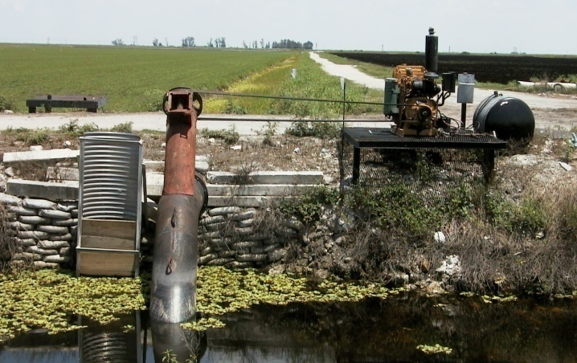
Installed booster pumps
Sod
Leaf
Cane
Still Lower P loads
Routing drainage water
internal to the farm can
greatly reduce reliance
on main farm pump.

Slide 10
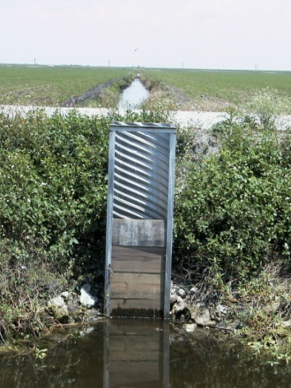
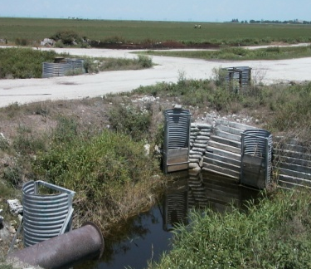
Coordinate crop rotations within contiguous field blocks
Install water control structures to allow independent WT management
Drain veggies fields first, then operate main discharge pumps only if needed
Plant rice in fallow fields during wet season; reduce need for off-farm pumping
Sod
Leaf
Cane
Lowest P loads
Hydraulic blocking of
like crops + independent
WT control achieves the
greatest potential for reducing off-farm drainage loads

Slide 11
Water Management BMPs
Recirculation
Enables the cultivation of higher P requiring crops without greatly impacting discharge water quality by rerouting high P water
Especially important for rice drawdown waters
Hydraulic Canal Dredging
Relocation of canal bottom sediments and particulate matter into fields by intensive targeted pumping (canal cleaning)
Notes:
11
Relocating sediments and particulates away from pumps and throwing it back onto the field

Slide 12
Field Drainage Process
Deep
Soil
Soil
Marl
Caprock
Shell rock
Shallow
Soil 1
Soil
Marl
Caprock
Shell rock
Shallow
Soil 2
Soil
Marl
Caprock
Shell rock

Slide 13
Field Drainage Process
Soil
Marl
Caprock
Organic sediment
Shell rock
Mineral sediment
velocity = (drainage flow rate)/(canal cross-sectional area)
m/sec = (m³/sec)/(m²)
Notes:
Higher velocity will increase the amount of organic sediment moving through those testing points. Don’t decrease the main canal too low, because then canal cross sectional area will decrease, increasing velocity which will stur up matter….

Slide 14
Rice BMPs
Rice is typically grown in bunded fields that are continuously flooded up to 7−14 days before harvest
Continuous flooding helps ensure sufficient water and control weeds
On average, it takes 1,400 L (370 gal) of water to produce 1 kg (2.2 lb) of rice in an irrigated production system (IRRI)
Seasonal water input to rice fields varies from as little as 40 cm in heavy clay soils with shallow groundwater tables to more than 200 cm in coarse-textured (sandy or loamy) soils with deep groundwater tables. For muck soils somewhere in between depending on thickness
Irrigated rice receives an estimated 34−43% of the total world’s irrigation water, or about 24−30% of the entire world’s developed fresh water resources (IRRI).
Notes:
Speaking of rice, I would like switch topics for a bit to talk……
Thank Jango…

Slide 15
To effectively and efficiently use water and maximize rice yields, the following good water management practices can be followed:
1. Construct field channels to control the flow of water to and from your field
2. Till the land to minimize water loss (or create a hardpan)
Prepare land to be laser leveled
retain soil moisture (raise water table)
3. Level the field
Avoid ponding, or raised patches
well-leveled field is crucial to good water management
4. Construct levees and fix any cracks or holes
Rice is extremely sensitive to water shortage (below saturation) at the flowering stage. Drought at flowering results in yield loss from increased spikelet sterility, thus fewer grains

Slide 16
Water Management Impact on Rice Yields and Drainage Water Quality in the EAA
Background
Everglades Forever Act, mandates a 25% P load reduction from the EAA basin when compared to the pre-BMP
Effects of mandatory BMPs in the EAA have shown improved water quality from sugarcane farms
Discharges from rice farms have not been thoroughly evaluated
Rice production has increased by more than 70% since 2008
Water quality impacts?
Production challenges (Rice yield and rice water weevil)?
Rice acreage and yields on the rise

Slide 17
Different crop establishment methods require different water management practices:
Continuous flooding
Continuous flooding of water generally provides the best growth environment for rice.
For direct seeded rice, field should be flooded only once the plants are large enough to withstand shallow flooding (3-4 leaf stage).
If transplanting, water levels should be around 3 cm initially, and gradually increase to 5−10 cm (with increasing plant height) and remain there until the field is drained before harvest.
Alternate wetting and drying (AWD)
For direct seeded rice, keep the soil moist but not saturated, to avoid seeds from rotting in the soil.
After sowing, apply a flush irrigation to wet the soil, if there is no rainfall.
Saturate the soil when plants have developed 3-4 leaves.
AWD can be started a few weeks (1-2) after planting. Irrigate and then allow the water depth to drop to 15 cm below the surface.
Once the water level has dropped to 15 cm below the surface, re-flood the field to a depth of 5 cm above the surface and repeat.
Notes:
One week before and after flowering should be flooded, to reduce spikelet sterility

Slide 18
Experimental Design
Study was conducted at the Everglades Research and Education Center
Summer of 2014 and 2015
Two dominant rice varieties in the EAA were selected, Cheniere and Taggart
Sowing method was dry-seeding with 112 kg/ha of FeSO4at a 2.4 ha field and no other fertilizer was applied
Flooding started 20 days after planting
Water treatments:
15 cm continuous flood (CF15)
5 cm continuous flood (CF5)
15 cm flood with drawdown (DD15)
5 cm flood with drawdown (DD5)
Four replications
Plots were flooded by canal water

Slide 19
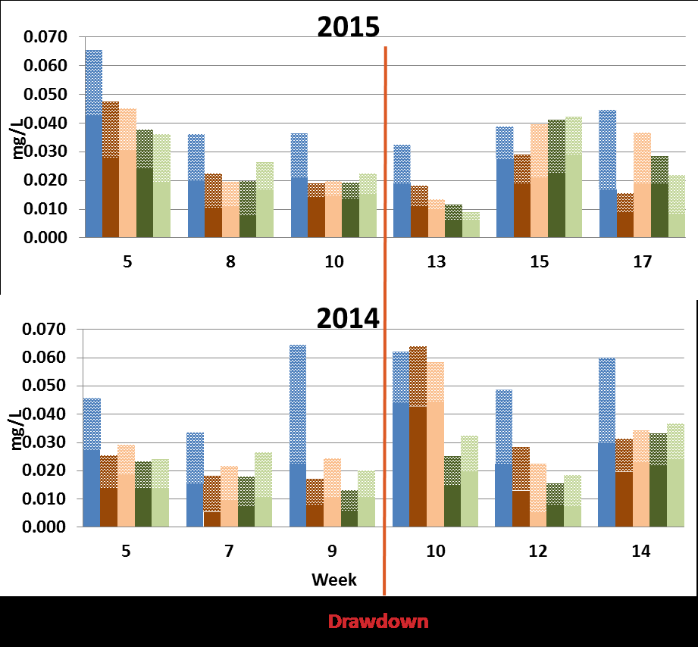
Total P and total dissolved P concentrations were reduced in both years by 42% and 38%, respectively
15 cm flood always had higher reductions of total P and total dissolved P than 5 cm flood
Drawdown did not show any significant effects on water quality parameters
Inflow
15cm Continuous Flood
5cm Continuous Flood
15cm Flood with Drawdown
5cm Flood with Drawdown
Particulate Phosphorus (PP)
Total Dissolved Phosphorus (TDP)

Slide 20
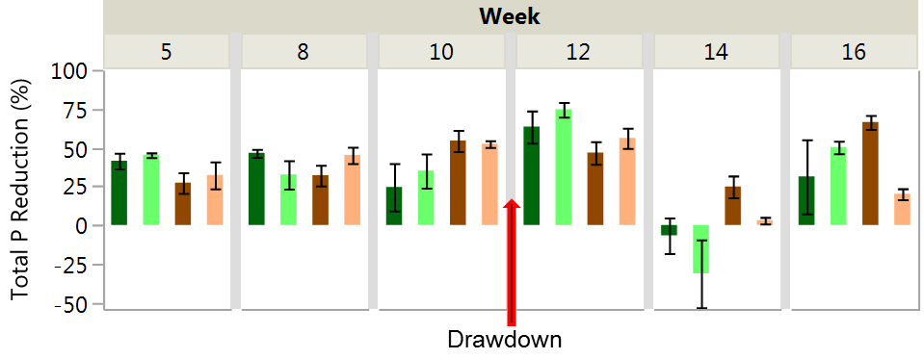
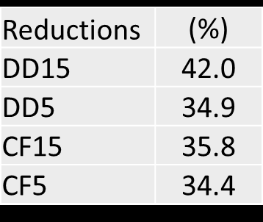
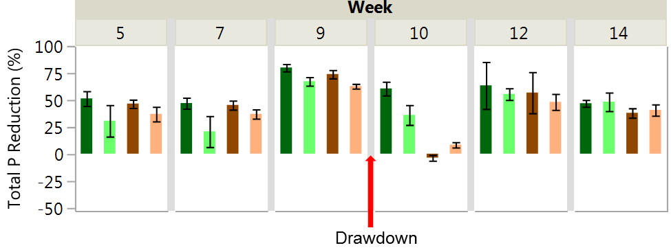
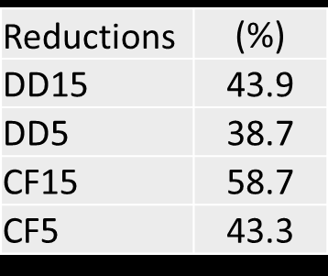
2015
2014
Treatment CF15 CF5 DD15 DD5

Slide 21
Thank you
Matthew VanWeelden, Ph.D.
UF / IFAS Extension
mvanweel1@ufl.edu
561-996-1656
Notes:
Introduce yourself. Thank people for coming. Go over main topics.

